Slide 1
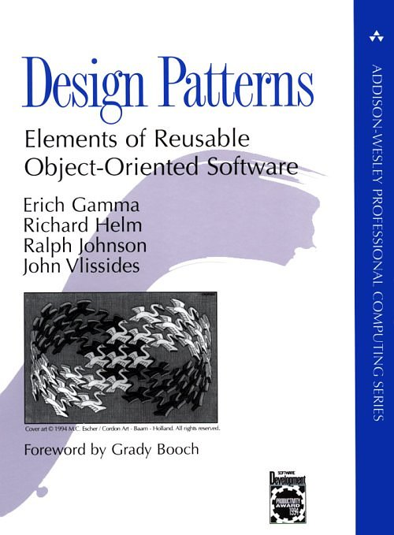
An Introduction to Design Patterns
Douglas C. Schmidt
Vanderbilt University www.dre.vanderbilt.edu/~schmidt/gof.ppt schmidt@dre.vanderbilt.edu
Based on material produced by John Vlissides

Slide 2
Overview
Part I: Motivation & Concept
  the issue
  what design patterns are
  what they’re good for
  how we develop & categorize them

Slide 3
Overview (cont’d)
Part II: Application
  use patterns to design a document editor
  demonstrate usage & benefits
Part III: Wrap-Up
  observations, caveats, & conclusion

Slide 4
Part I: Motivation & Concept
OOD methods emphasize design notations
  Fine for specification, documentation
But OOD is more than just drawing diagrams
  Good draftsmen  good designers
Good OO designers rely on lots of experience
  At least as important as syntax
Most powerful reuse is design reuse
  Match problem to design experience

Slide 5
Part I: Motivation & Concept (cont’d)
Recurring Design Structures
OO systems exhibit recurring structures that promote
  abstraction
  flexibility
  modularity
  elegance
Therein lies valuable design knowledge
Problem:
capturing, communicating, & applying this knowledge

Slide 6
Part I: Motivation & Concept (cont’d)
A Design Pattern…
abstracts a recurring design structure
comprises class and/or object
  dependencies
  structures
  interactions
  conventions
names & specifies the design structure explicitly
distills design experience

Slide 7
Part I: Motivation & Concept (cont’d)
Four Basic Parts
Name
Problem (including “forces”)
Solution
Consequences & trade-offs of application
Language- & implementation-independent
A “micro-architecture”
Adjunct to existing methodologies (RUP, Fusion, SCRUM, etc.)

Slide 8

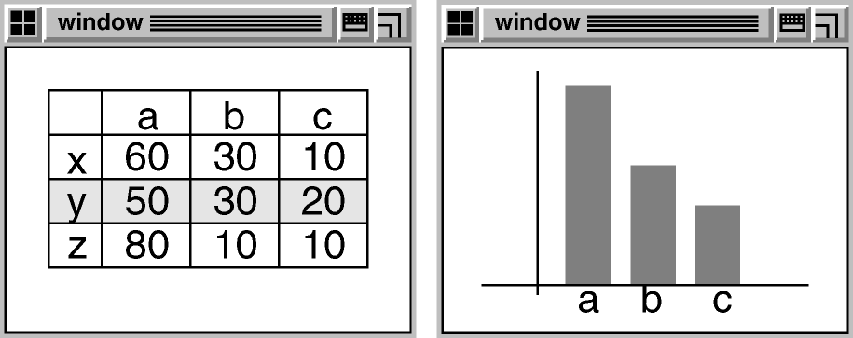
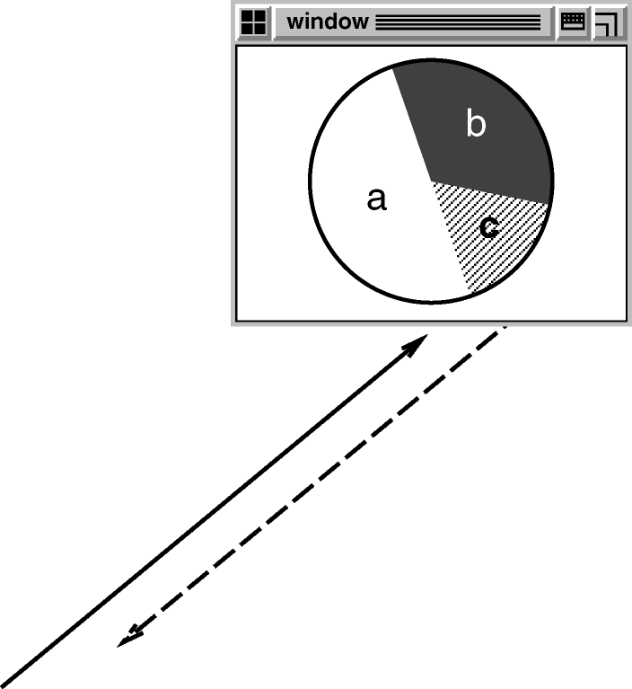
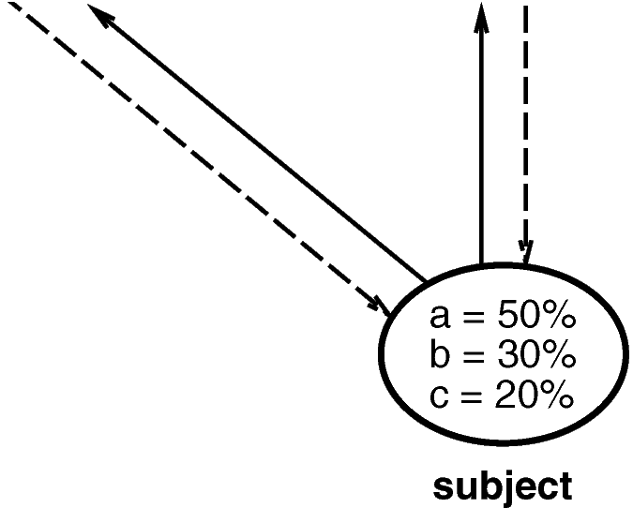

Part I: Motivation & Concept (cont’d)
Example: OBSERVER

Slide 9
Part I: Motivation & Concept (cont’d)
Goals
Codify good design
  distill & generalize experience
  aid to novices & experts alike
Give design structures explicit names
  common vocabulary
  reduced complexity
  greater expressiveness
Capture & preserve design information
  articulate design decisions succinctly
  improve documentation
Facilitate restructuring/refactoring
  patterns are interrelated
  additional flexibility

Slide 10
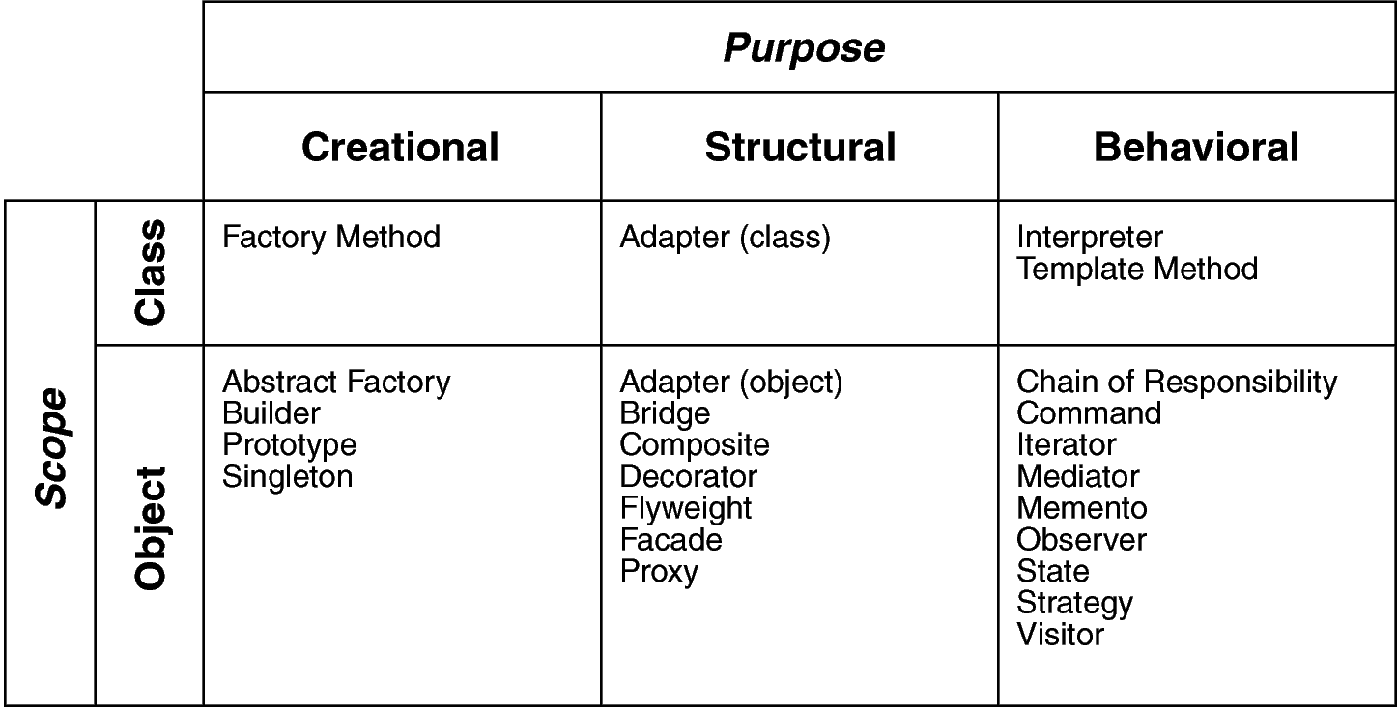
Part I: Motivation & Concept (cont’d)
Design Space for GoF Patterns
Scope: domain over which a pattern applies
Purpose: reflects what a pattern does

Slide 11
Part I: Motivation & Concept (cont’d)
Design Pattern Template (1st half)
NAME scope purpose
Intent
  short description of the pattern & its purpose
Also Known As
  Any aliases this pattern is known by
Motivation
  motivating scenario demonstrating pattern’s use
Applicability
  circumstances in which pattern applies
Structure
  graphical representation of the pattern using modified UML notation
Participants
  participating classes and/or objects & their responsibilities

Slide 12
Part I: Motivation & Concept (cont’d)
Design Pattern Template (2nd half)
...
Collaborations
  how participants cooperate to carry out their responsibilities
Consequences
  the results of application, benefits, liabilities
Implementation
  pitfalls, hints, techniques, plus language-dependent issues
Sample Code
  sample implementations in C++, Java, C#, Smalltalk, C, etc.
Known Uses
  examples drawn from existing systems
Related Patterns
  discussion of other patterns that relate to this one

Slide 13
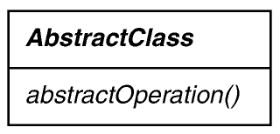
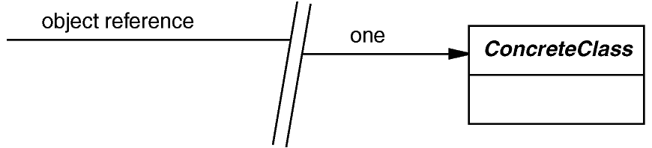



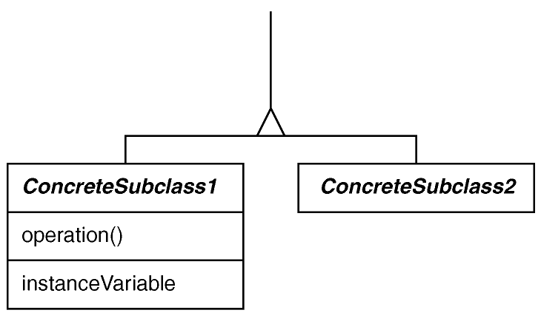
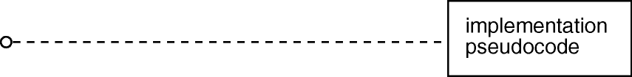
Part I: Motivation & Concept (cont’d)
Modified UML/OMT Notation

Slide 14
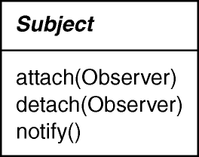
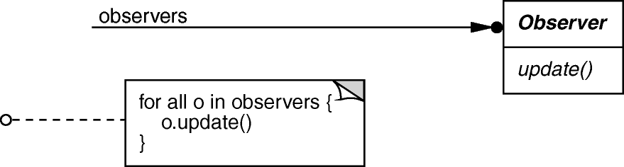
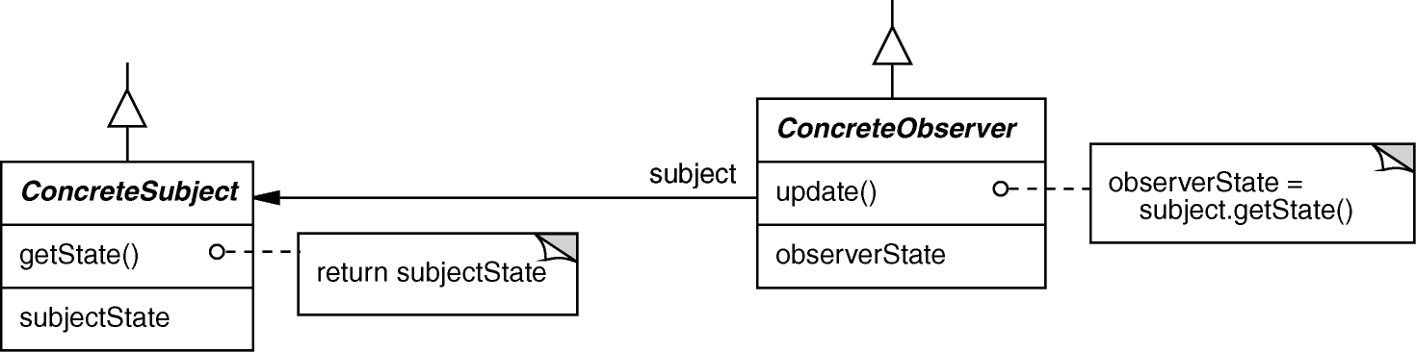
Motivation & Concept (cont’d)
OBSERVER object behavioral
Intent
  define a one-to-many dependency between objects so that when one object changes state, all dependents are notified & updated
Applicability
  an abstraction has two aspects, one dependent on the other
  a change to one object requires changing untold others
  an object should notify unknown other objects
Structure

Slide 15
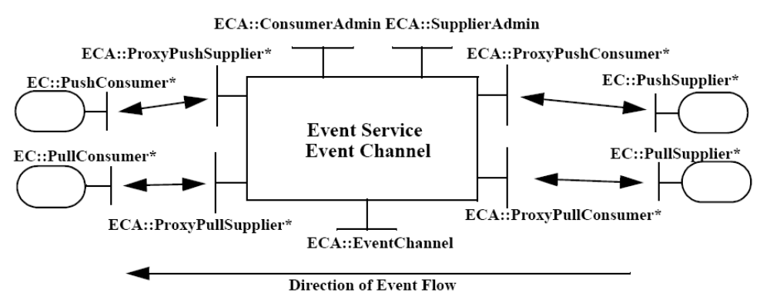
Motivation & Concept (cont’d)
OBSERVER object behavioral
class ProxyPushConsumer : public // …
virtual void push (const CORBA::Any &event) {
for (std::vector<PushConsumer>::iterator i
(consumers.begin ()); i != consumers.end (); i++)
(*i).push (event);
}
class MyPushConsumer : public // ….
virtual void push
(const CORBA::Any &event) { /* consume the event. */ }
CORBA Notification Service example using C++ Standard Template Library (STL) iterators (which is an example of the Iterator pattern from GoF)

Slide 16
Motivation & Concept (cont’d)
OBSERVER (cont’d) object behavioral
Consequences
  modularity: subject & observers may vary independently
  extensibility: can define & add any number of observers
  customizability: different observers offer different views of subject
  unexpected updates: observers don’t know about each other
  update overhead: might need hints or filtering
Implementation
  subject-observer mapping
  dangling references
  update protocols: the push & pull models
  registering modifications of interest explicitly
Known Uses
  Smalltalk Model-View-Controller (MVC)
  InterViews (Subjects & Views, Observer/Observable)
  Andrew (Data Objects & Views)
  Pub/sub middleware (e.g., CORBA Notification Service, Java Messaging Service)
  Mailing lists

Slide 17
Part I: Motivation & Concept (cont’d)
Benefits of Patterns
Design reuse
Uniform design vocabulary
Enhance understanding, restructuring, & team communication
Basis for automation
Transcends language-centric biases/myopia
Abstracts away from many unimportant details

Slide 18
Part I: Motivation & Concept (cont’d)
Liabilities of Patterns
Require significant tedious & error-prone human effort to handcraft pattern implementations design reuse
Can be deceptively simple uniform design vocabulary
May limit design options
Leaves some important details unresolved

Slide 19
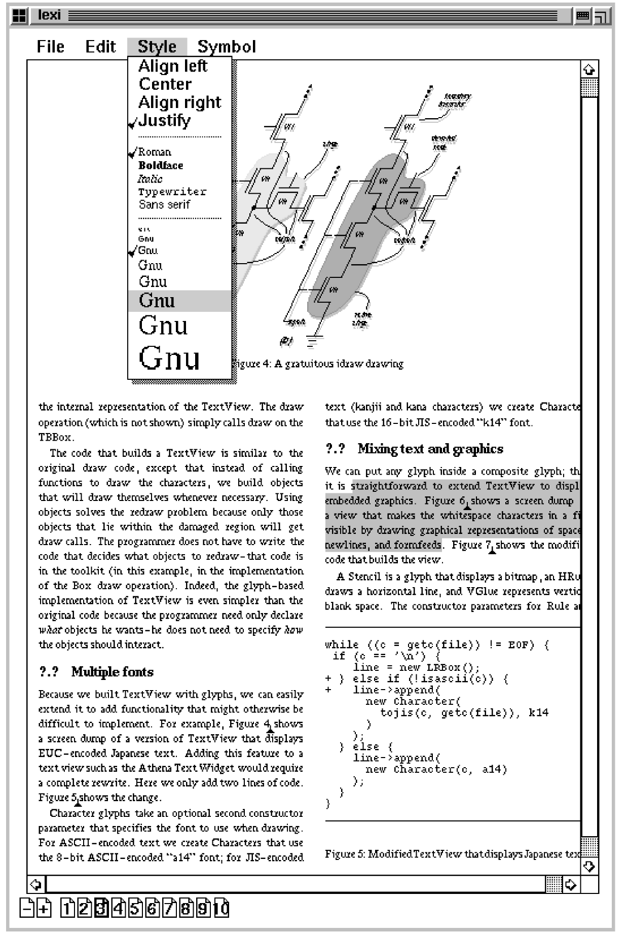
Part II: Application: Document Editor (Lexi)
7 Design Problems
Document structure
Formatting
Embellishment
Multiple look & feels
Multiple window systems
User operations
Spelling checking & hyphenation
Note that none of these patterns are restricted to document editors…

Slide 20
Document Structure
Goals:
  present document’s visual aspects
  drawing, hit detection, alignment
  support physical structure
  (e.g., lines, columns)
Constraints/forces:
  treat text & graphics uniformly
  no distinction between one & many

Slide 21
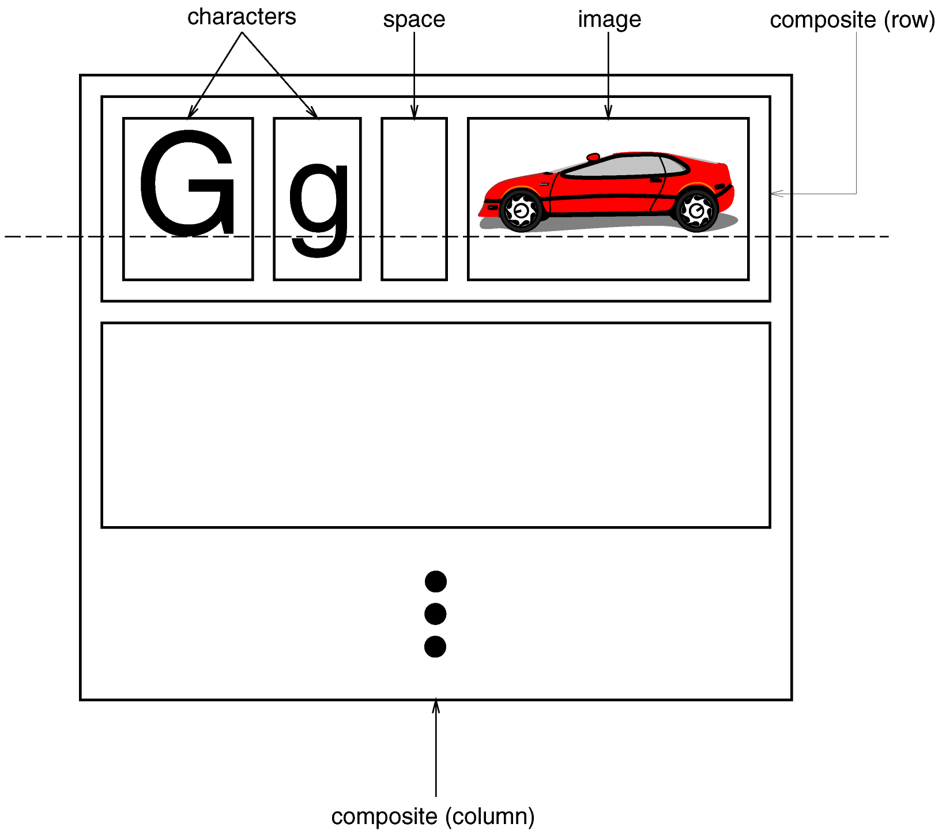
Document Structure (cont’d)
Solution: Recursive Composition

Slide 22
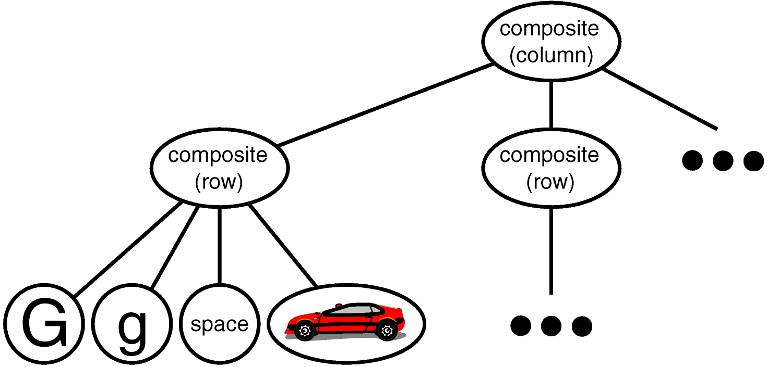
Document Structure (cont’d)
Object Structure

Slide 23
Document Structure (cont’d)
Glyph
Base class for composable graphical objects
Basic interface:
Task
Operations
appearance
void draw(Window)
hit detection
boolean intersects(Coord, Coord)
structure
void insert(Glyph)
void remove(Glyph)
Glyph child(int n)
Glyph parent()
Subclasses: Character, Image, Space, Row, Column

Slide 24
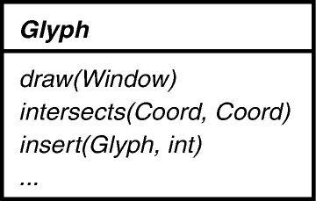
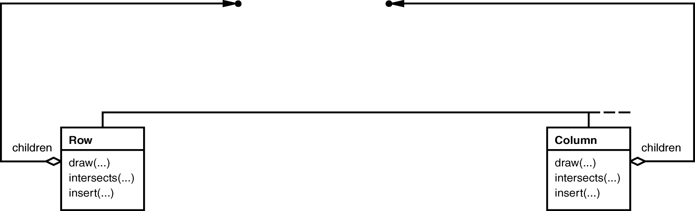
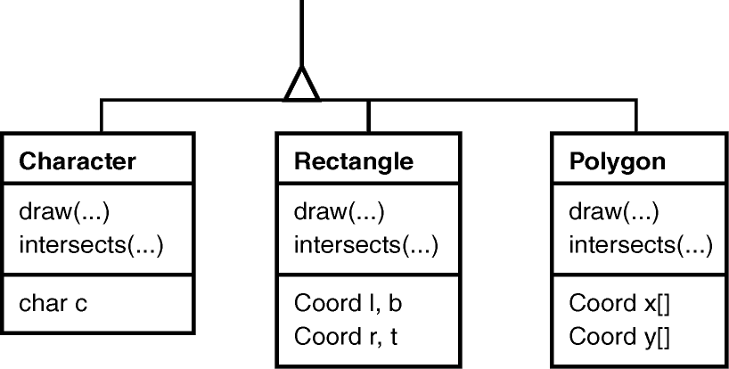
Document Structure (cont’d)
Glyph Hierarchy
Note the inherent recursion in this hierarchy
i.e., a Row is a Glyph & a Row also has Glyphs!

Slide 25
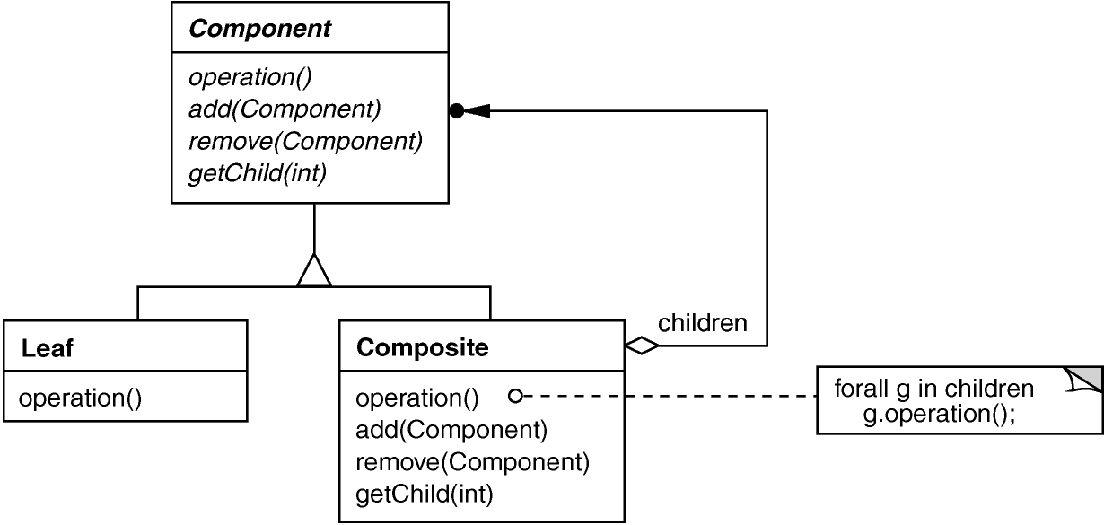
Document Structure (cont’d)
COMPOSITE object structural
Intent
  treat individual objects & multiple, recursively-composed objects uniformly
Applicability
  objects must be composed recursively,
  and no distinction between individual & composed elements,
  and objects in structure can be treated uniformly
e.g., Glyph
Structure
e.g., Character, Rectangle, etc.
e.g., Row, Column

Slide 26
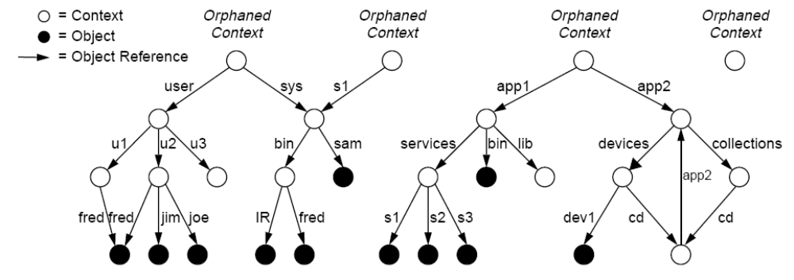
Document Structure (cont’d)
COMPOSITE object structural
Leaf Node
Composite Node
CORBA Naming Service example using CosNaming::BindingIterator (which is an example of the “Batch Iterator” pattern compound from POSA5)

Slide 27
Document Structure (cont’d)
COMPOSITE object structural
class Glyph {
public:
virtual void
draw (const Drawing_Region &) = 0;
// ...
protected:
int x_, y_; // Coordinate position.
};
class Character : public Glyph {
public:
Character
(const std::string &name);
// ...
virtual void
draw (const Drawing_Region &c)
{ c.draw_text (x_, y_, name_); }
private:
std::string name_;
};
Component
Composite
class Row : public Glyph {
public:
Row (std::vector<Glyph*> children);
// ...
virtual void
draw (const Drawing_Region &c){
for (std::vector<Glyph*>::iterator
i (children_);
i != children_.end ();
i++)
(*i)->draw (c);
}
// ...
private:
std::vector<Glyph*> children_;
// ...
};
Leaf

Slide 28
Document Structure (cont’d)
COMPOSITE object structural
void list_context (CosNaming::NamingContext_ptr nc) {
CosNaming::BindingIterator_var it; // Iterator reference
CosNaming::BindingList_var bl; // Binding list
const CORBA::ULong CHUNK = 100; // Chunk size
nc->list (CHUNK, bl, it); // Get first chunk
show_chunk (bl, nc); // Print first chunk
if (!CORBA::is_nil(it)) { // More bindings?
while (it->next_n(CHUNK, bl)) // Get next chunk
show_chunk (bl, nc); // Print chunk
it->destroy(); // Clean up
}
}
void show_chunk (const CosNaming::BindingList_ptr &bl, // Helper function
CosNaming::NamingContext_ptr nc) {
for (CORBA::ULong i = 0; i < bl.length (); ++i) {
cout << bl[i].binding_name[0].id << "." << bl[i].binding_name[0].kind;
if (bl[i].binding_type == CosNaming::ncontext) {
cout << ": context" << endl;
CORBA::Object_var obj = nc->resolve (bl[i].binding_name);
list_context (CosNaming::NamingContext::_narrow (obj));
}
else cout << ": reference" << endl;
}
}
Handle Composite Node
Handle Leaf Node

Slide 29
Document Structure (cont’d)
COMPOSITE (cont’d) object structural
Consequences
  uniformity: treat components the same regardless of complexity
  extensibility: new Component subclasses work wherever old ones do
  overhead: might need prohibitive numbers of objects
Implementation
  do Components know their parents?
  uniform interface for both leaves & composites?
  don’t allocate storage for children in Component base class
  responsibility for deleting children
Known Uses
  ET++ Vobjects
  InterViews Glyphs, Styles
  Unidraw Components, MacroCommands
  Directory structures on UNIX & Windows
  Naming Contexts in CORBA
  MIME types in SOAP

Slide 30
Formatting
Goals:
  automatic linebreaking, justification
Constraints/forces:
  support multiple linebreaking algorithms
  don’t tightly couple these algorithms with the document structure

Slide 31
Formatting (cont’d)
Solution: Encapsulate Linebreaking Strategy
Compositor
  base class abstracts linebreaking algorithm
  subclasses for specialized algorithms,
  e.g., SimpleCompositor, TeXCompositor
Composition
  composite glyph (typically representing a column)
  supplied a compositor & leaf glyphs
  creates row-column structure as directed by compositor

Slide 32
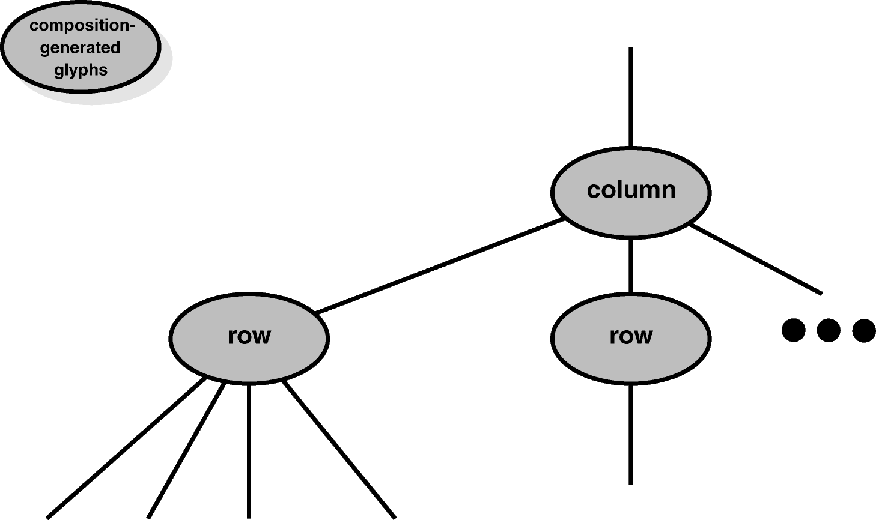
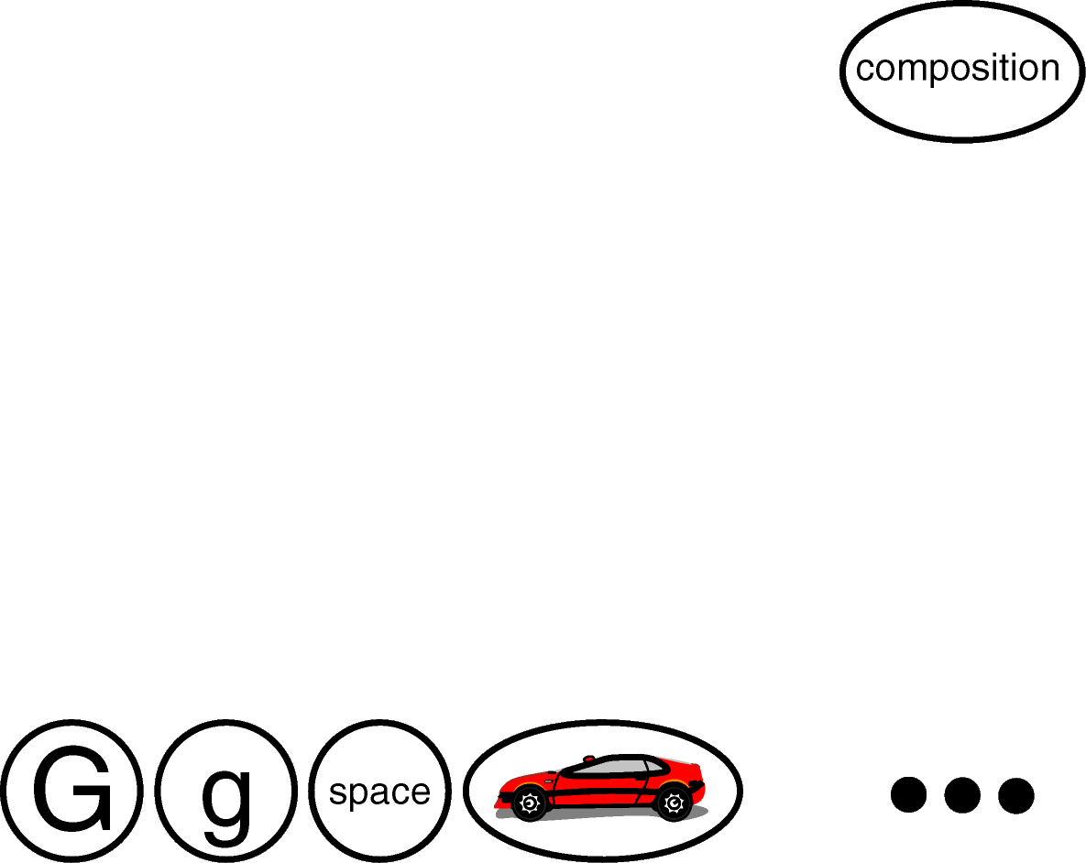
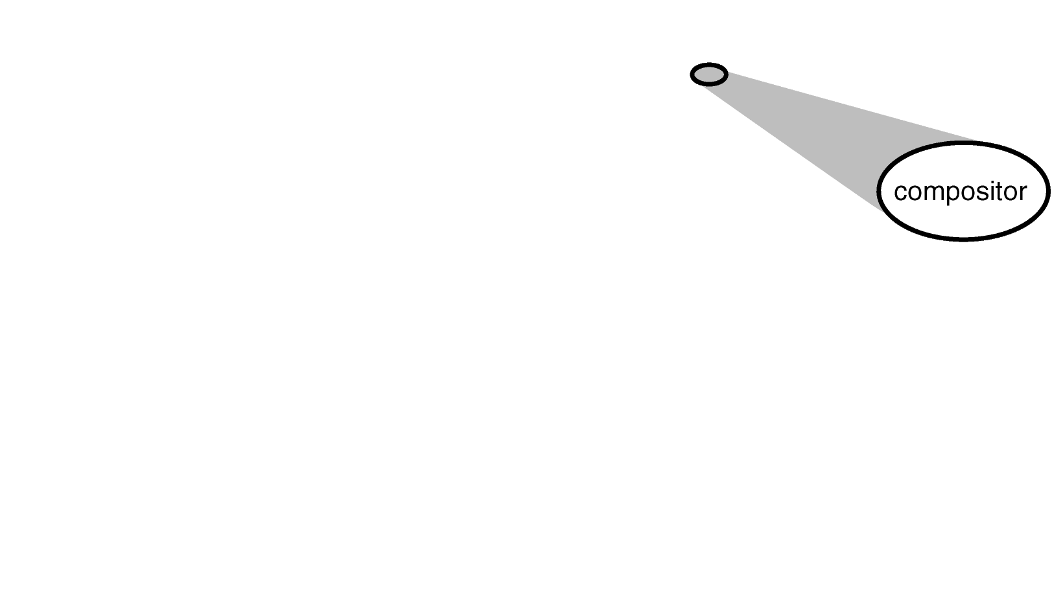
Formatting (cont’d)
New Object Structure
Generated in accordance with compositor strategies & do not affect contents of leaf glyphs

Slide 33
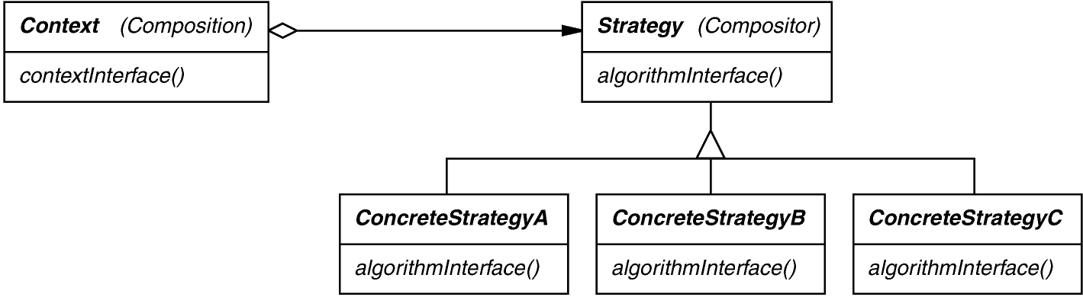
Formatting (cont’d)
STRATEGY object behavioral
Intent
  define a family of algorithms, encapsulate each one, & make them
  interchangeable to let clients & algorithms vary independently
Applicability
  when an object should be configurable with one of many algorithms,
  and all algorithms can be encapsulated,
  and one interface covers all encapsulations
Structure

Slide 34
Formatting (cont’d)
STRATEGY object behavioral
class Composition : public Glyph {
public:
void perform_composition (const Compositor &compositor,
const std::vector<Glyphs*> &leaf_glyphs) {
compositor.set_context (*this);
for (std::vector<Glyph*>::iterator
i (leaf_glyphs);
i != leaf_glyphs.end ();
i++) {
this->insert (*i);
compositor.compose ();
}
}
};
Simple algorithm
creates row-column structure as directed by compositor
class SimpleCompositor
: public Compositor {
public:
virtual void compose ()
{ /* ... */}
};
Complex algorithm
class Compositor {
public:
void set_context
(Composition &context);
virtual void compose () = 0;
// ...
};
class TexCompositor
: public Compositor {
public:
virtual void compose () { /* ... */}
};

Slide 35
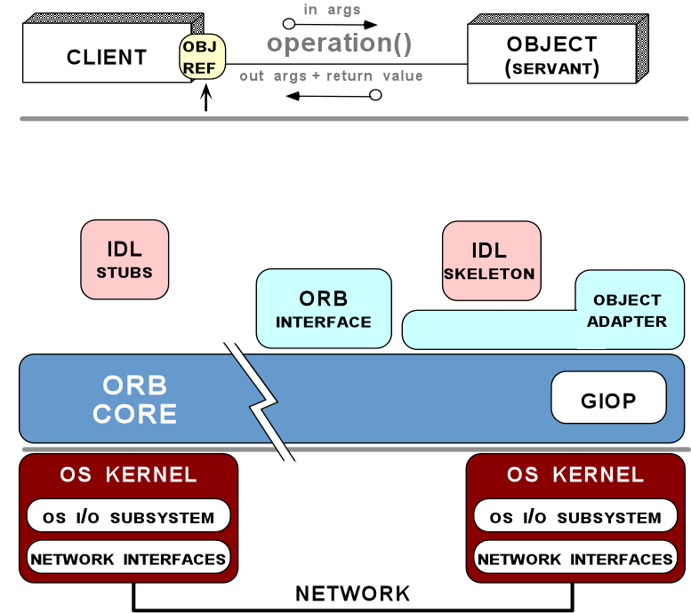
Formatting (cont’d)
STRATEGY object behavioral
Hook for marshaling strategy
Hook for the request demuxing strategy
Hook for the event demuxing strategy
Hook for the connection management strategy
Hook for the concurrency strategy
Hook for the underlying transport strategy
Strategy can also be applied in distributed systems (e.g., middleware)

Slide 36
Formatting (cont’d)
STRATEGY (cont’d) object behavioral
Consequences
  greater flexibility, reuse
  can change algorithms dynamically
  strategy creation & communication overhead
  inflexible Strategy interface
  semantic incompatibility of multiple strategies used together
Implementation
  exchanging information between a Strategy & its context
  static strategy selection via parameterized types
Known Uses
  InterViews text formatting
  RTL register allocation & scheduling strategies
  ET++SwapsManager calculation engines
  The ACE ORB (TAO) Real-time CORBA middleware
See Also
  Bridge pattern (object structural)

Slide 37
Formatting (cont’d)
Template Method (cont’d) class behavioral
Intent
  Provide a skeleton of an algorithm in a method, deferring some steps to subclasses
class Composition : public Glyph {
public:
// Template Method.
void perform_composition (const std::vector<Glyphs*> &leaf_glyphs) {
set_context (*this);
for (std::vector<Glyph*>::iterator i (leaf_glyphs);
i != leaf_glyphs.end (); i++) {
insert (*i);
compose ();
}
}
virtual void compose () = 0; // Hook Method.
};
class Simple_Composition : public Composition {
virtual void compose () { /* ... */ }
};
class Tex_Composition : public Composition {
virtual void compose () { /* ... */ }
};

Slide 38
Formatting (cont’d)
Template Method (cont’d) class behavioral
Intent
  Provide a skeleton of an algorithm in a method, deferring some steps to subclasses
class Base_Class {
public:
// Template Method.
void template_method (void) {
hook_method_1 ();
hook_method_2 ();
// ...
}
virtual void hook_method_1 () = 0;
virtual void hook_method_2 () = 0;
};
class Derived_Class_1 : public Base_Class {
virtual void hook_method_2 () { /* ... */ }
};
class Derived_Class_2 : public Base_Class {
virtual void hook_method_1 () { /* ... */ }
virtual void hook_method_2 () { /* ... */ }
};

Slide 39
Embellishment
Goals:
  add a frame around text composition
  add scrolling capability
Constraints/forces:
  embellishments should be reusable without subclassing, i.e., so they can be added dynamically at runtime
  should go unnoticed by clients

Slide 40
Embellishment (cont’d)
Solution: “Transparent” Enclosure
Monoglyph
  base class for glyphs having one child
  operations on MonoGlyph (ultimately) pass through to child
MonoGlyph subclasses:
  Frame: adds a border of specified width
  Scroller: scrolls/clips child, adds scrollbars

Slide 41
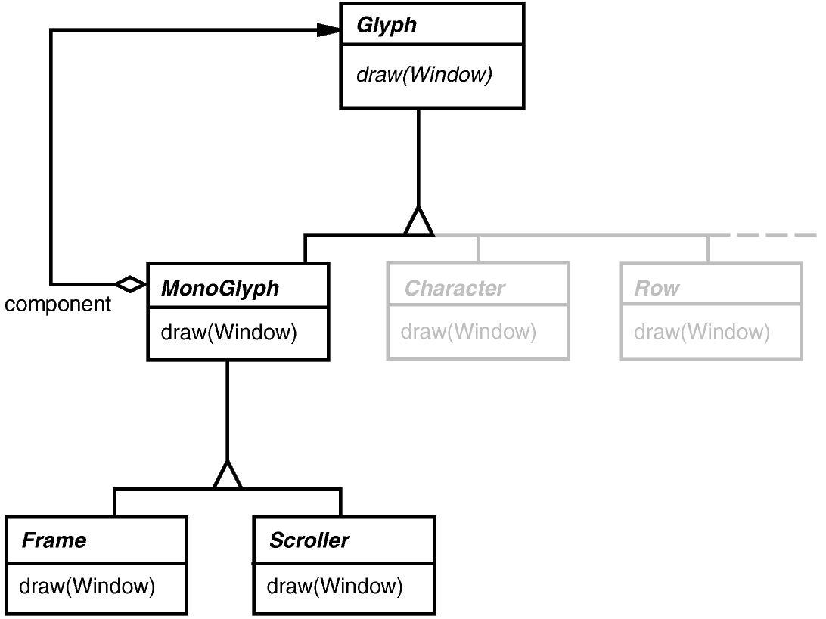
Embellishment (cont’d)
MonoGlyph Hierarchy
void Frame::draw (Window &w) {
// Order may be important!
MonoGlyph::draw (w);
drawFrame (w);
}
void MonoGlyph::draw (Window &w) {
component->draw (w);
}

Slide 42
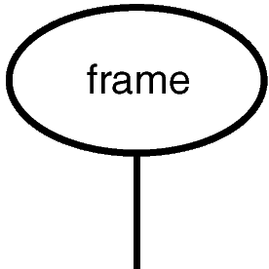
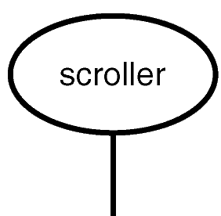
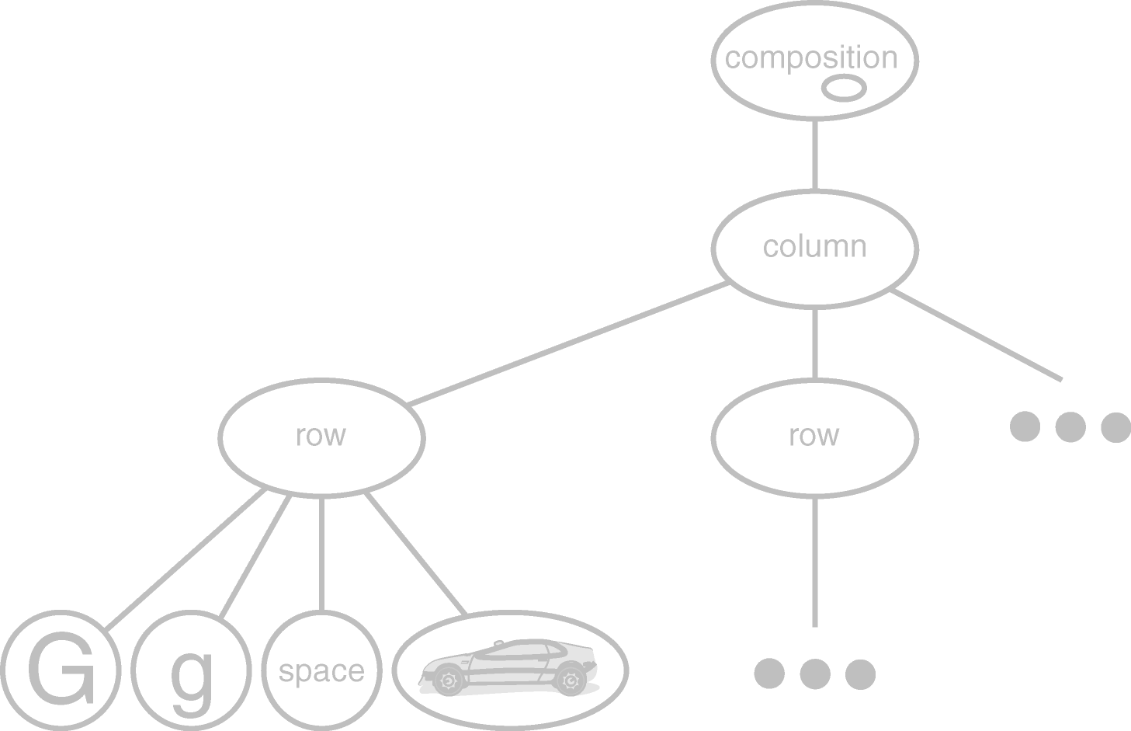
Embellishment (cont’d)
New Object Structure

Slide 43
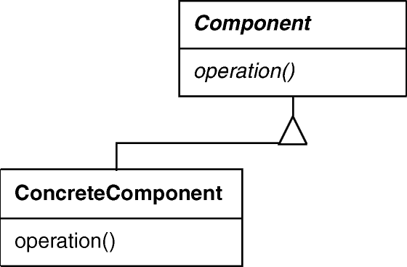
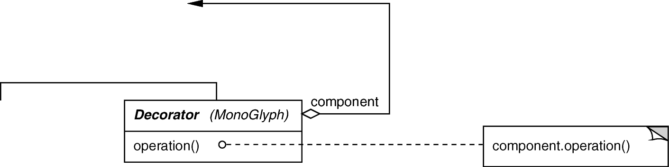
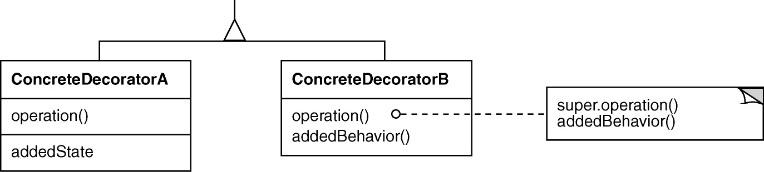
Embellishment (cont’d)
DECORATOR object structural
Intent
  Transparently augment objects with new responsibilities dynamically
Applicability
  when extension by subclassing is impractical
  for responsibilities that can be added & withdrawn dynamically
Structure

Slide 44
Embellishment (cont’d)
DECORATOR object structural
size_t request_count;
void *worker_task (void *) {
request_count++;
// ... process the request
}
ACE_Thread_Mutex m;
size_t request_count;
void *worker_task (void *) {
m.acquire ();
request_count++;
m.release ();
// ... process the request
}
ACE_Thread_Mutex m;
size_t request_count;
void *worker_task (void *) {
{
ACE_Guard <ACE_Thread_Mutex> g (m);
request_count++;
}
// ... process the request
}

Slide 45
Embellishment (cont’d)
DECORATOR object structural
Atomic_Op<size_t, ACE_Thread_Mutex> request_count;
void *worker_task (void *) {
request_count++;
// ... process the request
}
template <typename T, typename LOCK>
class Atomic_Op {
public:
void operator++ () {
ACE_Guard <LOCK> g (m_);
count_++;
// ...
}
private:
T count_;
LOCK m_;
};

Slide 46
Embellishment (cont’d)
DECORATOR (cont’d) object structural
Consequences
  responsibilities can be added/removed at run-time
  avoids subclass explosion
  recursive nesting allows multiple responsibilities
  interface occlusion
  identity crisis
  composition of decorators is hard if there are side-effects
Implementation
  interface conformance
  use a lightweight, abstract base class for Decorator
  heavyweight base classes make Strategy more attractive
Known Uses
  embellishment objects from most OO-GUI toolkits
  ParcPlace PassivityWrapper
  InterViews DebuggingGlyph
  Java I/O classes
  ACE_Atomic_Op

Slide 47
Multiple Look & Feels
Goals:
  support multiple look & feel standards
  generic, Motif, Swing, PM, Macintosh, Windows, ...
  extensible for future standards
Constraints/forces:
  don’t recode existing widgets or clients
  switch look & feel without recompiling

Slide 48
Multiple Look & Feels (cont’d)
Solution: Abstract Object Creation
Instead of
MotifSrollbar *sb = new MotifScrollbar();
use
Scrollbar *sb = factory->createScrollbar();
where factory is an instance of MotifFactory
BTW, this begs the question of who created the factory!

Slide 49
Multiple Look & Feels (cont’d)
Factory Interface
defines “manufacturing interface”
subclasses produce specific products
subclass instance chosen at run-time
// This class is essentially a Java interface
class GUIFactory {
public:
virtual Scrollbar *createScrollbar() = 0;
virtual Menu *createMenu() = 0;
...
};

Slide 50
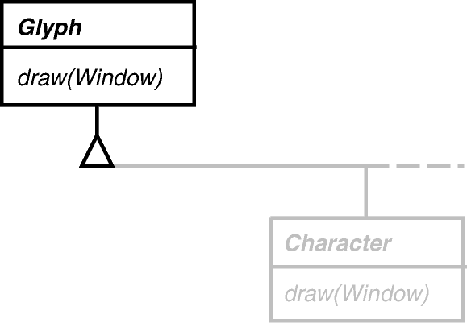
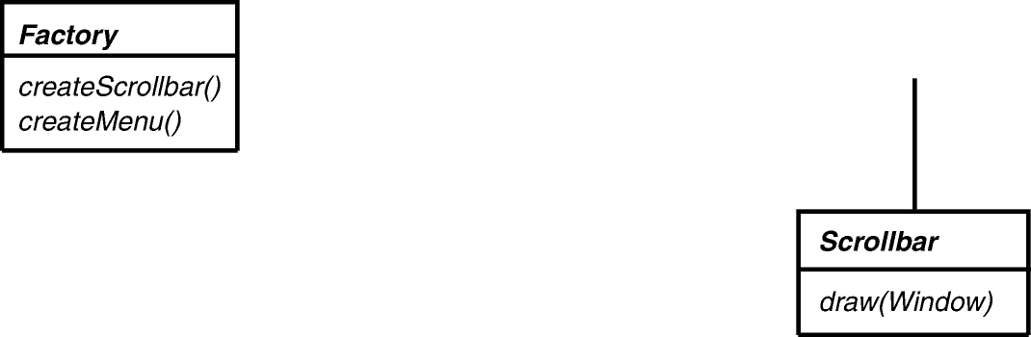
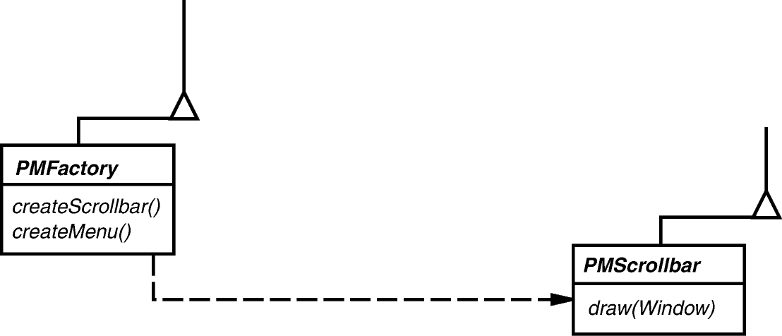
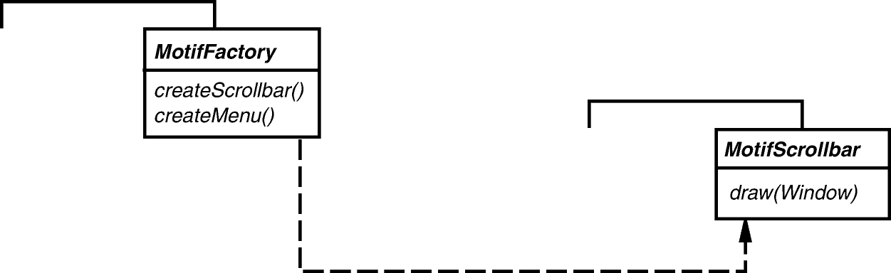
Multiple Look & Feels (cont’d)
Factory Structure
Scrollbar *MotifFactory::createScrollBar () {
return new MotifScrollbar();
}
Scrollbar *PMFactory::createScrollBar () {
return new PMScrollbar();
}

Slide 51
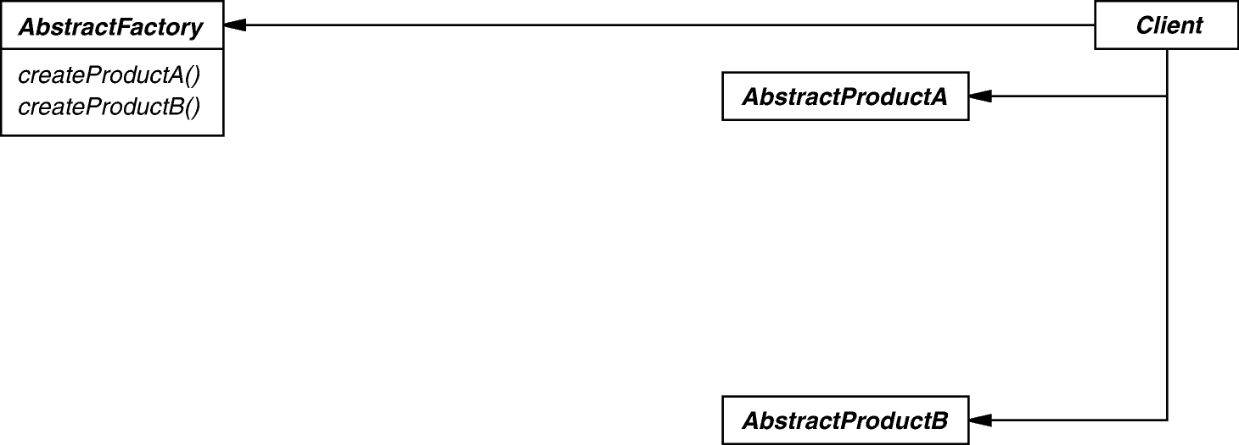
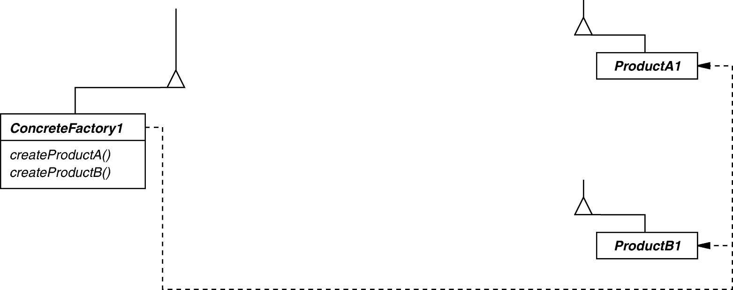
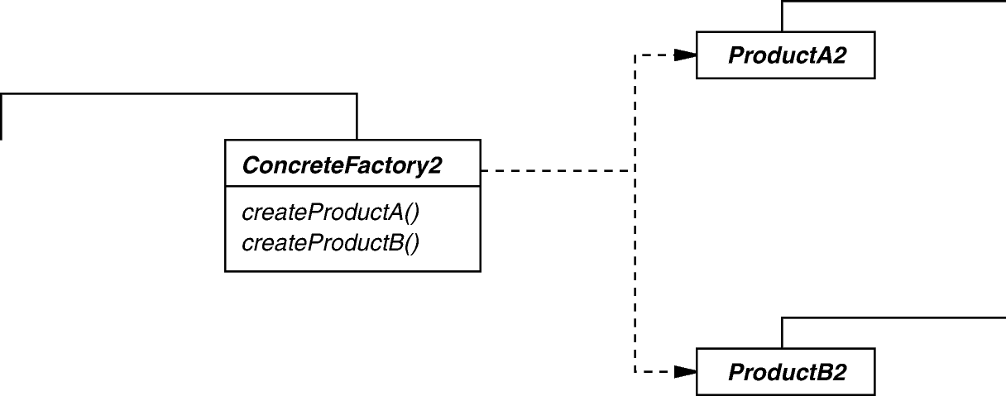
Multiple Look & Feels (cont’d)
ABSTRACT FACTORY object creational
Intent
  create families of related objects without specifying subclass names
Applicability
  when clients cannot anticipate groups of classes to instantiate
Structure

Slide 52
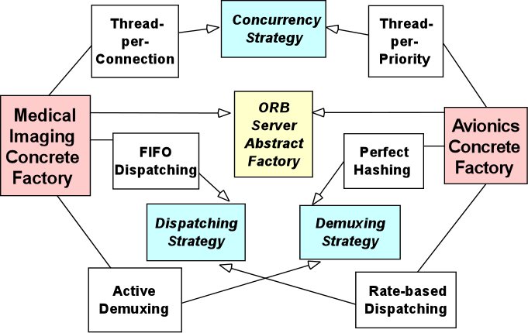
Multiple Look & Feels (cont’d)
ABSTRACT FACTORY object creational
Concrete factories create groups of strategies

Slide 53
Multiple Look & Feels (cont’d)
ABSTRACT FACTORY (cont’d) object creational
Consequences
  flexibility: removes type (i.e., subclass) dependencies from clients
  abstraction & semantic checking: hides product’s composition
  hard to extend factory interface to create new products
Implementation
  parameterization as a way of controlling interface size
  configuration with Prototypes, i.e., determines who creates the factories
  abstract factories are essentially groups of factory methods
Known Uses
  InterViews Kits
  ET++ WindowSystem
  AWT Toolkit
  The ACE ORB (TAO)

Slide 54
Multiple Window Systems
Goals:
  make composition appear in a window
  support multiple window systems
Constraints/forces:
  minimize window system dependencies in application & framework code

Slide 55
Multiple Window Systems (cont’d)
Solution: Encapsulate Implementation Dependencies
Window
  user-level window abstraction
  displays a glyph (structure)
  window system-independent
  task-related subclasses
  (e.g., IconWindow, PopupWindow)

Slide 56
Multiple Window Systems (cont’d)
Window Interface
class Window {
public:
...
void iconify(); // window-management
void raise();
...
void drawLine(...); // device-independent
void drawText(...); // graphics interface
...
};

Slide 57
Multiple Window Systems (cont’d)
Window uses a WindowRep
abstract implementation interface
encapsulates window system dependencies
window systems-specific subclasses
(e.g., XWindowRep, SunWindowRep)
An Abstract Factory can produce the right WindowRep!

Slide 58
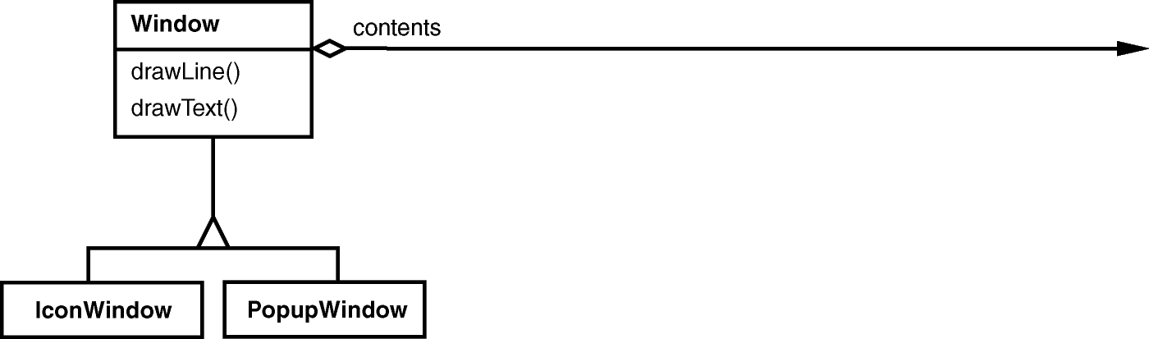
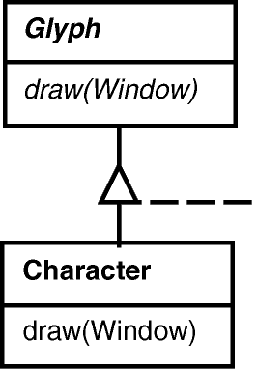
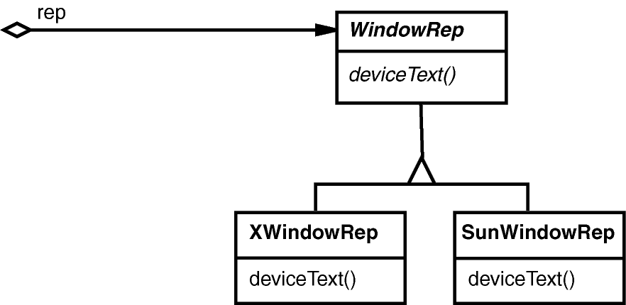
Multiple Window Systems (cont’d)
Window/WindowRep Structure
void Character::draw (Window &w) {
w.drawText(...);
}
void Window::drawText (...) {
rep->deviceText(...);
}
void XWindowRep::deviceText (...) {
XText(...);
}

Slide 59

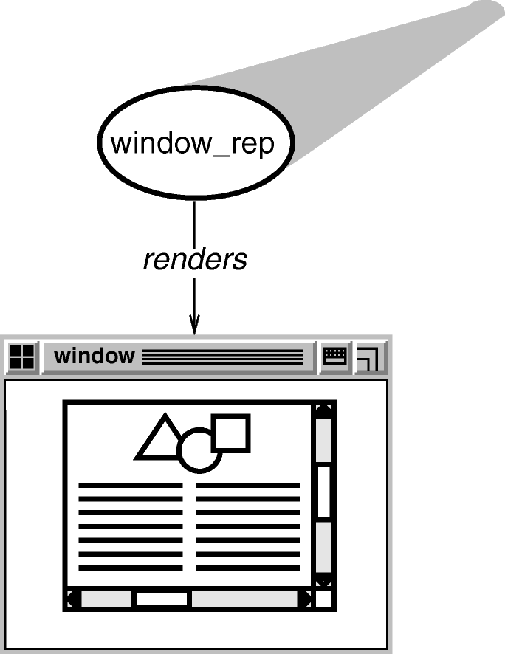
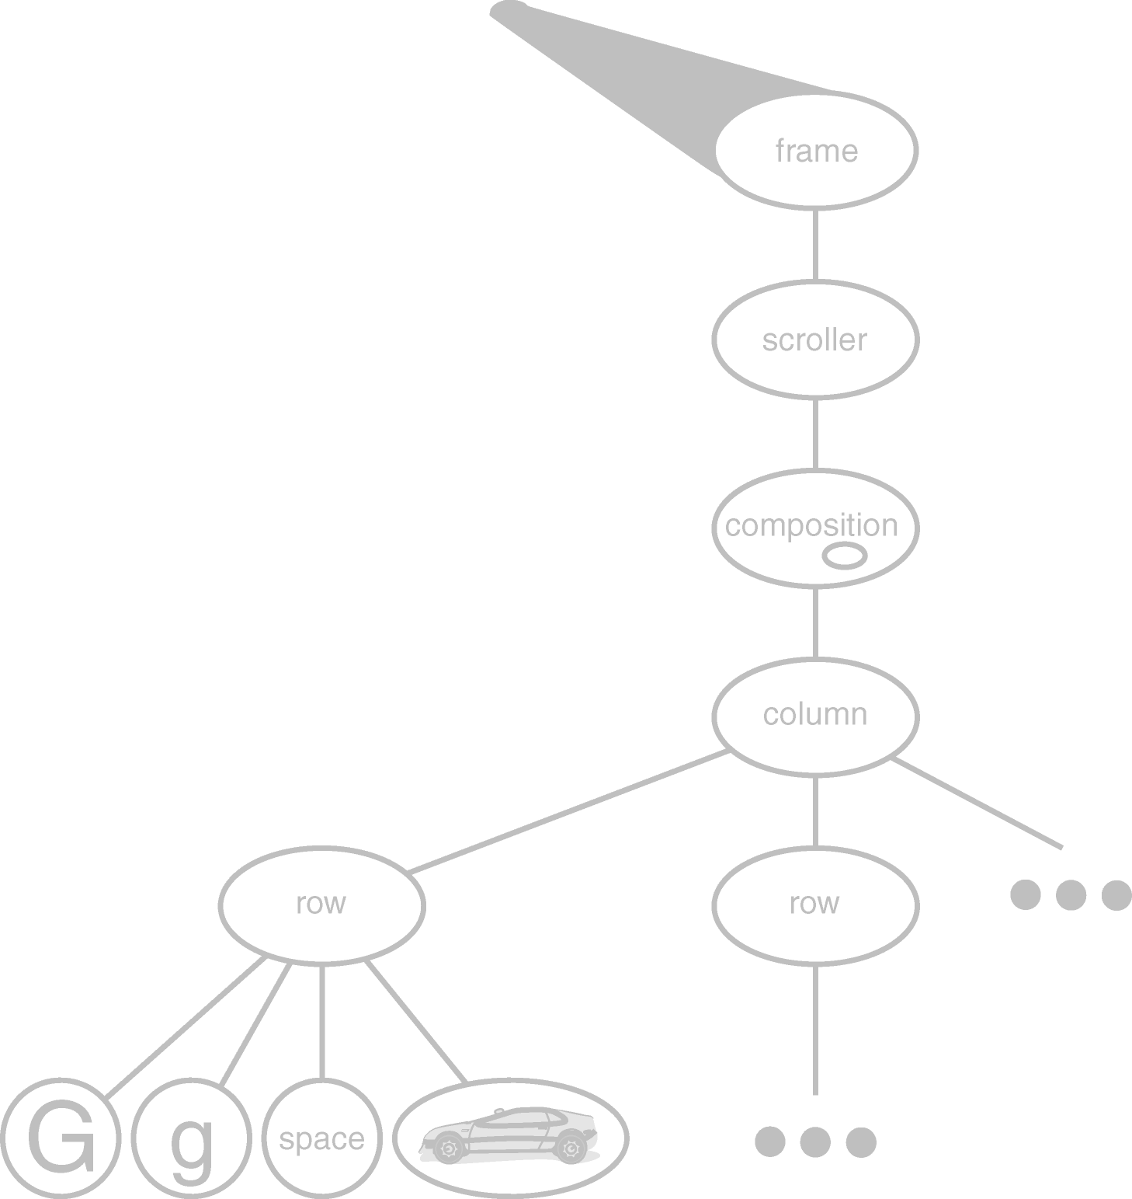
Multiple Window Systems (cont’d)
New Object Structure
Note the decoupling between the logical structure of the contents in a window from the physical rendering of the contents in the window

Slide 60
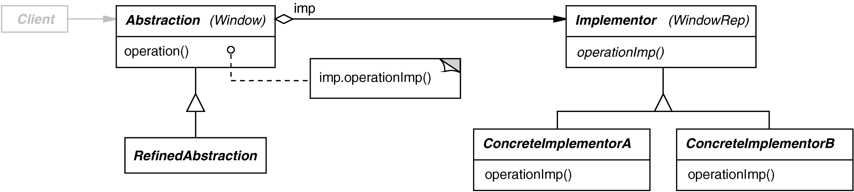
Multiple Window Systems (cont’d)
BRIDGE object structural
Intent
  separate a (logical) abstraction interface from its (physical) implementation(s)
Applicability
  when interface & implementation should vary independently
  require a uniform interface to interchangeable class hierarchies
Structure

Slide 61
Multiple Window Systems (cont’d)
BRIDGE (cont’d) object structural
Consequences
  abstraction interface & implementation are independent
  implementations can vary dynamically
  one-size-fits-all Abstraction & Implementor interfaces
Implementation
  sharing Implementors & reference counting
  creating the right Implementor (often use factories)
Known Uses
  ET++ Window/WindowPort
  libg++ Set/{LinkedList, HashTable}
  AWT Component/ComponentPeer

Slide 62
User Operations
Goals:
  support execution of user operations
  support unlimited-level undo/redo
Constraints/forces:
  scattered operation implementations
  must store undo state
  not all operations are undoable

Slide 63
User Operations (cont’d)
Solution: Encapsulate Each Request
A Command encapsulates
  an operation (execute())
  an inverse operation (unexecute())
  a operation for testing reversibility
  (boolean reversible())
  state for (un)doing the operation
Command may
  implement the operations itself, or
  delegate them to other object(s)

Slide 64
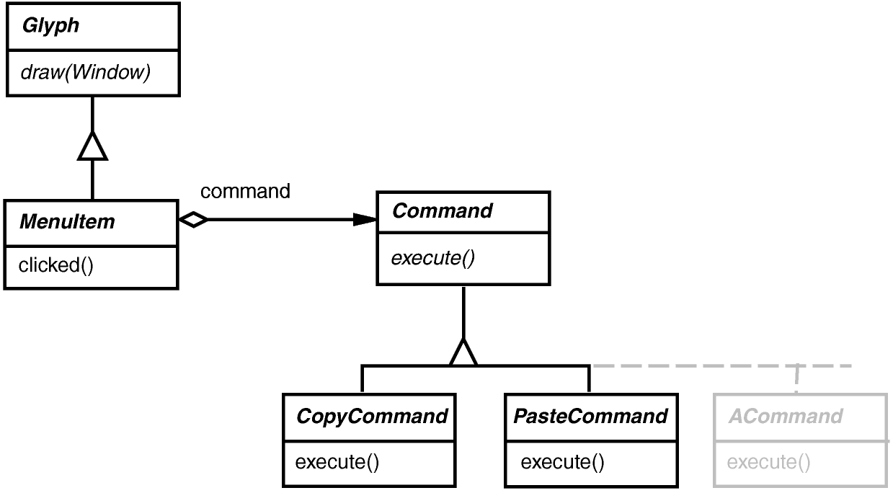
User Operations (cont’d)
Command Hierarchy
void PasteCommand::execute () {
// do the paste
}
void CopyCommand::execute () {
// do the copy
}
void MenuItem::clicked () {
command->execute();
}

Slide 65
User Operations (cont’d)
List of Commands = Execution History
Undo:
unexecute()
unexecute()
Redo:
execute()
unexecute()
cmd
cmd
cmd
cmd
past
future
past
future

Slide 66
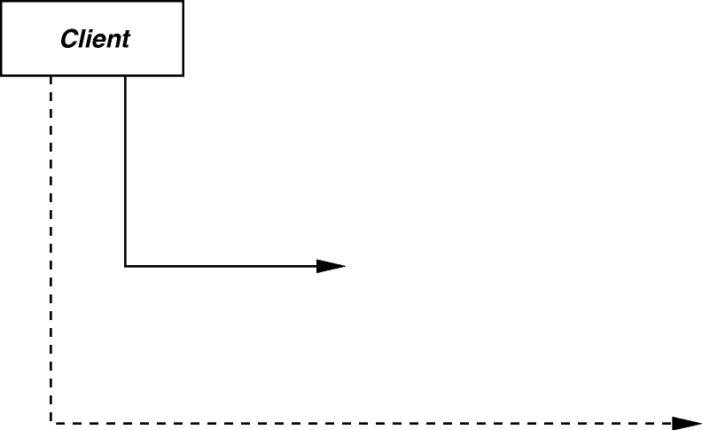

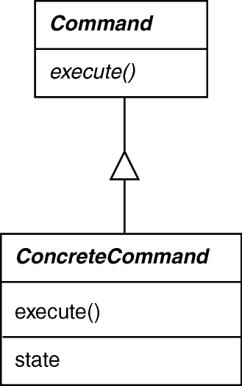

User Operations (cont’d)
COMMAND object behavioral
Intent
  encapsulate the request for a service
Applicability
  to parameterize objects with an action to perform
  to specify, queue, & execute requests at different times
  for multilevel undo/redo
Structure

Slide 67
User Operations (cont’d)
COMMAND (cont’d) object behavioral
Consequences
  abstracts executor of a service
  supports arbitrary-level undo-redo
  composition yields macro-commands
  might result in lots of trivial command subclasses
Implementation
  copying a command before putting it on a history list
  handling hysteresis
  supporting transactions
Known Uses
  InterViews Actions
  MacApp, Unidraw Commands
  JDK’s UndoableEdit, AccessibleAction
  Emacs

Slide 68
Spelling Checking & Hyphenation
Goals:
  analyze text for spelling errors
  introduce potential hyphenation sites
Constraints/forces:
  support multiple algorithms
  don’t tightly couple algorithms with document structure

Slide 69


Spelling Checking & Hyphenation (cont’d)
Solution: Encapsulate Traversal
Iterator
  encapsulates a traversal algorithm without exposing representation details to callers
  uses Glyph’s child enumeration operation
  This is an example of a “preorder iterator”

Slide 70

Spelling Checking & Hyphenation (cont’d)
ITERATOR object behavioral
Intent
  access elements of a container without exposing its representation
Applicability
  require multiple traversal algorithms over a container
  require a uniform traversal interface over different containers
  when container classes & traversal algorithm must vary independently
Structure

Slide 71
Spelling Checking & Hyphenation (cont’d)
ITERATOR (cont’d) object behavioral
Iterators are used heavily in the C++ Standard Template Library (STL)
int main (int argc, char *argv[]) {
vector<string> args;
for (int i = 0; i < argc; i++)
args.push_back (string (argv[i]));
for (vector<string>::iterator i (args.begin ());
i != args.end ();
i++)
cout << *i;
cout << endl;
return 0;
}
The same iterator pattern can be applied to any STL container!
for (Glyph::iterator i = glyphs.begin ();
i != glyphs.end ();
i++)
...

Slide 72
Spelling Checking & Hyphenation (cont’d)
ITERATOR (cont’d) object behavioral
Consequences
  flexibility: aggregate & traversal are independent
  multiple iterators & multiple traversal algorithms
  additional communication overhead between iterator & aggregate
Implementation
  internal versus external iterators
  violating the object structure’s encapsulation
  robust iterators
  synchronization overhead in multi-threaded programs
  batching in distributed & concurrent programs
Known Uses
  C++ STL iterators
  JDK Enumeration, Iterator
  Unidraw Iterator

Slide 73
Spelling Checking & Hyphenation (cont’d)
Visitor
defines action(s) at each step of traversal
avoids wiring action(s) into Glyphs
iterator calls glyph’s accept(Visitor) at each node
accept() calls back on visitor (a form of “static polymorphism” based on method overloading by type)
void Character::accept (Visitor &v) { v.visit (*this); }
class Visitor {
public:
virtual void visit (Character &);
virtual void visit (Rectangle &);
virtual void visit (Row &);
// etc. for all relevant Glyph subclasses
};

Slide 74
Spelling Checking & Hyphenation (cont’d)
SpellingCheckerVisitor
gets character code from each character glyph
  Can define getCharCode() operation just on Character() class
checks words accumulated from character glyphs
combine with PreorderIterator
class SpellCheckerVisitor : public Visitor {
public:
virtual void visit (Character &);
virtual void visit (Rectangle &);
virtual void visit (Row &);
// etc. for all relevant Glyph subclasses
Private:
std::string accumulator_;
};

Slide 75



Spelling Checking & Hyphenation (cont’d)
Accumulating Words
Spelling check performed when a nonalphabetic character it reached

Slide 76








Spelling Checking & Hyphenation (cont’d)
Interaction Diagram
The iterator controls the order in which accept() is called on each glyph in the composition
accept() then “visits” the glyph to perform the desired action
The Visitor can be subclassed to implement various desired actions

Slide 77
Spelling Checking & Hyphenation (cont’d)
HyphenationVisitor
gets character code from each character glyph
examines words accumulated from character glyphs
at potential hyphenation point, inserts a...
class HyphenationVisitor : public Visitor {
public:
void visit (Character &);
void visit (Rectangle &);
void visit (Row &);
// etc. for all relevant Glyph subclasses
};

Slide 78

Spelling Checking & Hyphenation (cont’d)
Discretionary Glyph
looks like a hyphen when at end of a line
has no appearance otherwise
Compositor considers its presence when determining linebreaks

Slide 79



Spelling Checking & Hyphenation (cont’d)
VISITOR object behavioral
Intent
  centralize operations on an object structure so that they can vary independently but still behave polymorphically
Applicability
  when classes define many unrelated operations
  class relationships of objects in the structure rarely change, but the operations on them change often
  algorithms keep state that’s updated during traversal
Structure

Slide 80
Spelling Checking & Hyphenation (cont’d)
VISITOR (cont’d) object behavioral
SpellCheckerVisitor spell_check_visitor;
for (Glyph::iterator i = glyphs.begin ();
i != glyphs.end ();
i++) {
(*i)->accept (spell_check_visitor);
}
HyphenationVisitor hyphenation_visitor;
for (Glyph::iterator i = glyphs.begin ();
i != glyphs.end ();
i++) {
(*i)->accept (hyphenation_visitor);
}

Slide 81
Spelling Checking & Hyphenation (cont’d)
VISITOR (cont’d) object behavioral
Consequences
  flexibility: visitor & object structure are independent
  localized functionality
  circular dependency between Visitor & Element interfaces
  Visitor brittle to new ConcreteElement classes
Implementation
  double dispatch
  general interface to elements of object structure
Known Uses
  ProgramNodeEnumerator in Smalltalk-80 compiler
  IRIS Inventor scene rendering
  TAO IDL compiler to handle different backends

Slide 82
Part III: Wrap-Up
Observations
Patterns are applicable in all stages of the OO lifecycle
  analysis, design, & reviews
  realization & documentation
  reuse & refactoring
Patterns permit design at a more abstract level
  treat many class/object interactions as a unit
  often beneficial after initial design
  targets for class refactorings
Variation-oriented design
  consider what design aspects are variable
  identify applicable pattern(s)
  vary patterns to evaluate tradeoffs
  repeat

Slide 83
Part III: Wrap-Up (cont’d)
But…
Don’t apply them blindly
  Added indirection can yield increased complexity, cost
Resist branding everything a pattern
  Articulate specific benefits
  Demonstrate wide applicability
  Find at least three existing examples from code other than your own!
Pattern design even harder than OO design!

Slide 84
Part III: Wrap-Up (cont’d)
Concluding Remarks
design reuse
uniform design vocabulary
understanding, restructuring, & team communication
provides the basis for automation
a “new” way to think about design

Slide 85
Pattern References
Books
Timeless Way of Building, Alexander, ISBN 0-19-502402-8
A Pattern Language, Alexander, 0-19-501-919-9
Design Patterns, Gamma, et al., 0-201-63361-2 CD version 0-201-63498-8
Pattern-Oriented Software Architecture, Vol. 1, Buschmann, et al.,
0-471-95869-7
Pattern-Oriented Software Architecture, Vol. 2, Schmidt, et al.,
0-471-60695-2
Pattern-Oriented Software Architecture, Vol. 3, Jain & Kircher,
0-470-84525-2
Pattern-Oriented Software Architecture, Vol. 4, Buschmann, et al.,
0-470-05902-8
Pattern-Oriented Software Architecture, Vol. 5, Buschmann, et al.,
0-471-48648-5

Slide 86
Pattern References (cont’d)
More Books
Analysis Patterns, Fowler; 0-201-89542-0
Concurrent Programming in Java, 2nd ed., Lea, 0-201-31009-0
Pattern Languages of Program Design
Vol. 1, Coplien, et al., eds., ISBN 0-201-60734-4
Vol. 2, Vlissides, et al., eds., 0-201-89527-7
Vol. 3, Martin, et al., eds., 0-201-31011-2
Vol. 4, Harrison, et al., eds., 0-201-43304-4
Vol. 5, Manolescu, et al., eds., 0-321-32194-4
AntiPatterns, Brown, et al., 0-471-19713-0
Applying UML & Patterns, 2nd ed., Larman, 0-13-092569-1
Pattern Hatching, Vlissides, 0-201-43293-5
The Pattern Almanac 2000, Rising, 0-201-61567-3

Slide 87
Pattern References (cont’d)
Even More Books
Small Memory Software, Noble & Weir, 0-201-59607-5
Microsoft Visual Basic Design Patterns, Stamatakis, 1-572-31957-7
Smalltalk Best Practice Patterns, Beck; 0-13-476904-X
The Design Patterns Smalltalk Companion, Alpert, et al.,
0-201-18462-1
Modern C++ Design, Alexandrescu, ISBN 0-201-70431-5
Building Parsers with Java, Metsker, 0-201-71962-2
Core J2EE Patterns, Alur, et al., 0-130-64884-1
Design Patterns Explained, Shalloway & Trott, 0-201-71594-5
The Joy of Patterns, Goldfedder, 0-201-65759-7
The Manager Pool, Olson & Stimmel, 0-201-72583-5

Slide 88
Pattern References (cont’d)
Early Papers
“Object-Oriented Patterns,” P. Coad; Comm. of the ACM, 9/92
“Documenting Frameworks using Patterns,” R. Johnson; OOPSLA ’92
“Design Patterns: Abstraction & Reuse of Object-Oriented Design,” Gamma, Helm, Johnson, Vlissides, ECOOP ’93
Articles
Java Report, Java Pro, JOOP, Dr. Dobb’s Journal,
Java Developers Journal, C++ Report

Slide 89
Pattern-Oriented Conferences
PLoP 2007: Pattern Languages of Programs
October 2007, Collocated with OOPSLA
EuroPLoP 2007, July 2007, Kloster Irsee, Germany
…
See hillside.net/conferences/ for
up-to-the-minute info.

Slide 90
Mailing Lists
patterns@cs.uiuc.edu: present & refine patterns
patterns-discussion@cs.uiuc.edu: general discussion
gang-of-4-patterns@cs.uiuc.edu: discussion on Design Patterns
siemens-patterns@cs.uiuc.edu: discussion on
Pattern-Oriented Software Architecture
ui-patterns@cs.uiuc.edu: discussion on user interface patterns
business-patterns@cs.uiuc.edu: discussion on patterns for business processes
ipc-patterns@cs.uiuc.edu: discussion on patterns for distributed systems
See http://hillside.net/patterns/mailing.htm for an up-to-date list.

